Slide 1
Delta Regional Authority
Program Overview
May 2023
www.dra.gov

Slide 2
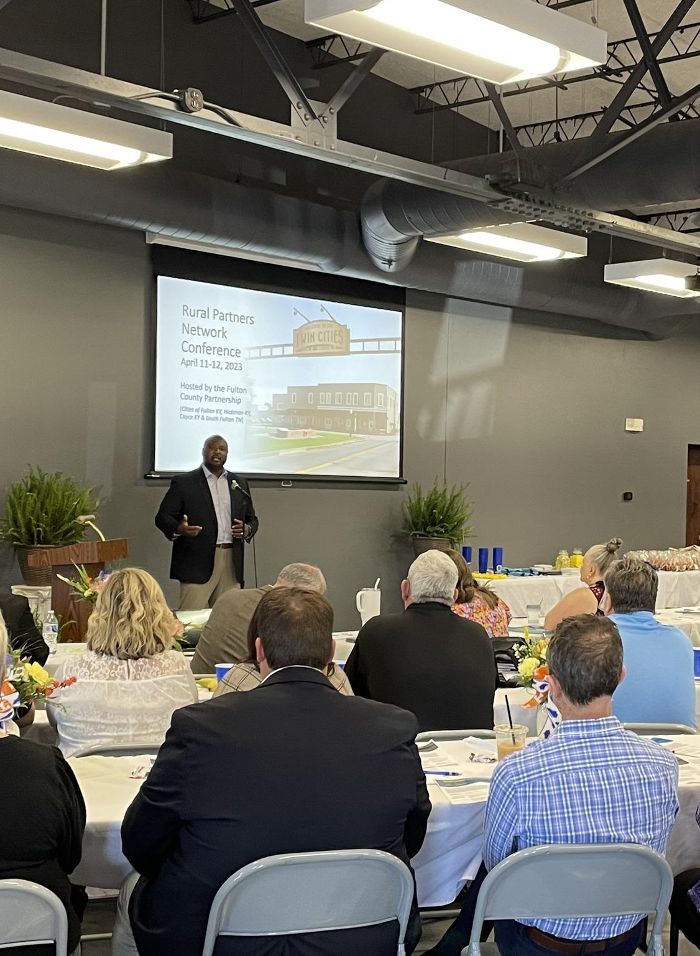
Moving The Delta Forward
The DRA was established in 2000 as a formal framework for joint Federal-State collaboration to promote and encourage the economic development of the lower Mississippi River and Alabama Black Belt regions. To fulfill this purpose, DRA invests in projects supporting transportation infrastructure, basic public infrastructure, workforce training, and business development. DRA works to create jobs, build communities, and improve the lives of those that reside in the region. DRA’s region encompasses 252 counties and parishes in parts of Alabama, Arkansas, Illinois, Kentucky, Louisiana, Mississippi, Missouri, and Tennessee.
DRA’s enabling legislation dictates that at least 75% of DRA’s funds must be invested in economically distressed counties and parishes and isolated areas within non-distressed counties and parishes. In addition, half of DRA’s funds must support transportation infrastructure and basic public infrastructure.
DRA.GOV
1

Slide 3
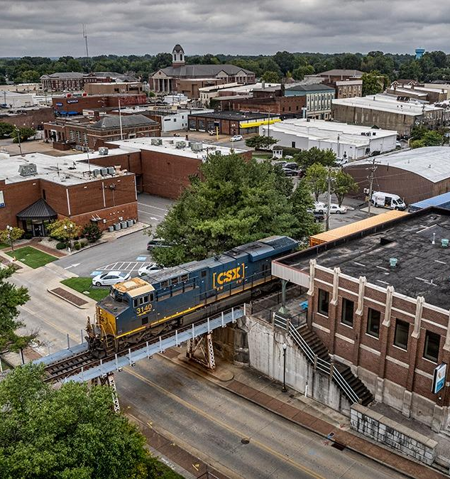
Creating Jobs.
Building Communities. Improving Lives.
DRA envisions the region as a place where people and businesses have access to economic opportunities in vibrant, sustainable, and resilient communities. DRA’s mission is to realize that vision through the practical application of innovative ideas and strategies that will foster inclusive communities, strengthen regional collaboration and productive capacity, achieve sustained, long-term economic development, and produce meaningful opportunities for all people in the DRA region.
2
DRA.GOV

Slide 4
Our Programs
DRA supports and promotes economic development within the lower Mississippi River Delta and Alabama Black Belt regions through its programming opportunities. Designed to make strategic investments in critical and human infrastructure, DRA’s programming aims to impact economic growth and opportunity in economically distressed communities.”
Critical Infrastructure | Human Infrastructure | Capacity-Building
States Economic Development Assistance Program (SEDAP) | Health | LLD Community Support Pilot Program
Community Infrastructure Fund (CIF) | Leadership | Strategic Planning Program
Public Works and Economic Adjustment Assistance (PWEAA) | Workforce
3
DRA.GOV

Slide 5
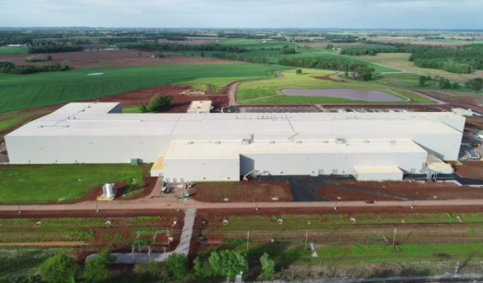
Critical Infrastructure
States’ Economic Development Assistance Program (SEDAP)
As one of DRA’S main investment tools, SEDAP provides direct investments for basic public infrastructure, transportation infrastructure, business development with an emphasis on entrepreneurship, and workforce development. From 2017-2022, SEDAP projects facilitated these impacts:
504,297 Total Families Affected by Infrastructure Projects
164,197 Total Individuals Trained
35,409 Jobs Created or Retained
SEDAP 2024 Funding
Total Funds Available: Approx. $17 Million
Grant Award Minimum: $50,000
Grant Award Maximum: $500,000
Funding Cycle Opens: March 26, 2024
Funding Cycle Closes: June 25, 2024
DRA.GOV
4

Slide 6
Critical Infrastructure
Community Infrastructure Fund (CIF)
CIF complements SEDAP as a primary investment tool for DRA. Investments support projects that address flood control, basic public infrastructure, and transportation infrastructure improvements. Since 2017, CIF projects facilitated these impacts:
298,505 Total Families Affected by Infrastructure Projects
1,537 Total Individuals Trained
8,020 Total Jobs Created or Retained
Community Infrastructure Fund 2024 Funding
Total Funds Available: Approx. $30 Million
Grant Award Minimum: $500,000
Grant Award Maximum: $2,000,000
Funding Cycle Opens: March 11, 2024
Application Deadline: Annual Rolling Cycle
DRA.GOV
5

Slide 7
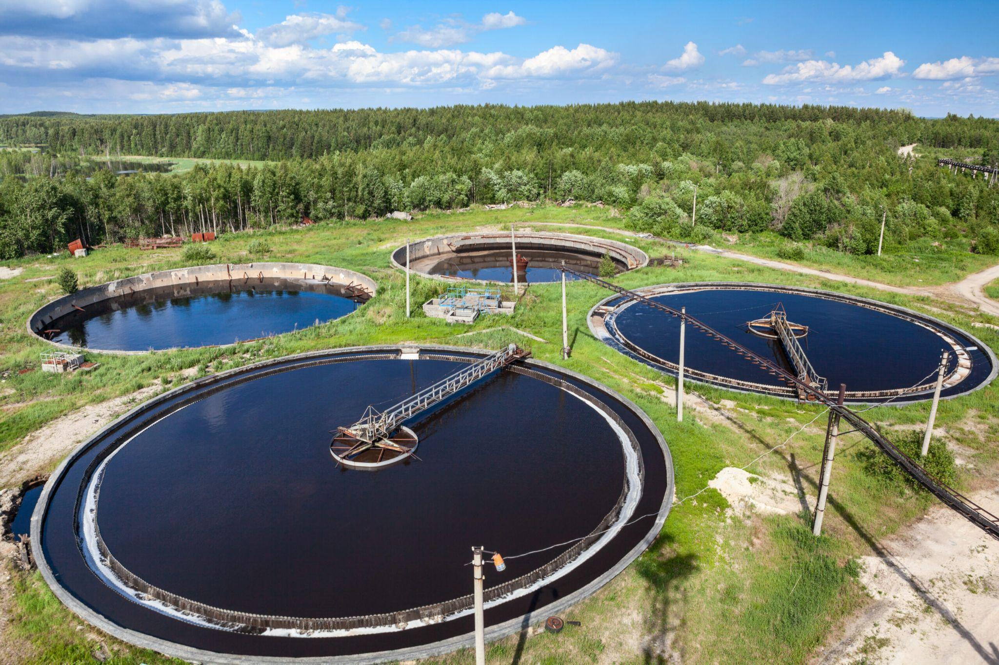
Critical Infrastructure
Public Works and Economic Adjustment Assistance (PWEAA)
Public Works Program
EDA’s Public Works program helps distressed communities revitalize, expand, and upgrade their physical infrastructure. This program enables communities to attract new industry; encourage business expansion; diversify local economies; and generate or retain long-term, private-sector jobs and investment through the acquisition or development of land and infrastructure improvements needed for the successful establishment or expansion of industrial or commercial enterprises.
Economic Adjustment Assistance Program
The EAA program provides a wide range of technical, planning, and public works and infrastructure assistance in regions experiencing adverse economic changes that may occur suddenly or over time. These adverse economic impacts may result from a steep decline in manufacturing employment following a plant closure, changing trade patterns, catastrophic natural disaster, a military base closure, or environmental changes and regulations.
DRA.GOV
6

Slide 8
Human Infrastructure
Health
Our belief is that health is an economic engine and will drive future economic growth. The growing incidence of chronic disease in Delta communities poses a threat to the lives, livelihoods, productivity, and economic vitality of the Delta region, and DRA is committed to improving these health outcomes through a number of programs and partnerships.
Delta Doctors boosts healthcare access in Delta communities by assisting non-domestic physicians trained in this country to work in underserved areas.
Innovative Readiness Training collaborates with the U.S. Department of Defense and military reserves to provide cost-free medical, dental, and optical care to Delta residents in need through the Innovative Readiness Training program.
Delta Region Community Health Systems Development – Technical Assistance Program - through intensive technical assistance - help health care providers in select rural communities are helped to identify and address health care needs while strengthening the local health care system.
Delta Region Rural Health Workforce Training Program develops Strategic Networks to address the need for trained administrative support professionals in rural healthcare facilities, providing training, certifications, and pathways to employment for current and new workers.
DRA.GOV
7

Slide 9
Human Infrastructure
Delta Leadership Institute
The Delta Leadership Institute (DLI) is designed to improve the decisions made by community leaders across the region by strengthening leadership capacity and mutual understanding of regional, state, and local cultures and issues.
Delta Leadership Institute Executive Academy
DRA invests in regional leadership through its annual Delta Leadership Institute Executive Academy. Fellows representing each of the eight DRA states are selected by the eight governors and the Federal Co-Chairman from a competitive pool of applicants that represent both public and private sectors. During the 9-month executive leadership development program, six sessions are held in different cities throughout the eight-state region, which focus on areas such as transportation infrastructure, government relations, and regional collaboration.
DRA.GOV
8

Slide 10
Human Infrastructure
Workforce
Delta Workforce Grant Program
The Delta Workforce Grant Program (DWP) is an initiative designed to build long-term community capacity and increase economic competitiveness by providing grants to support workforce training and education programs throughout the Mississippi River Delta and Alabama Black Belt regions.
DWP supports projects and initiatives that create a more vibrant economic future for the Delta region by expanding opportunities to recruit, train, and retain a diverse and local workforce, aligning workforce and economic development strategies, creating sustainable talent pipelines, establishing or enhancing locally/regionally significant sector-based partnerships, and supporting enhanced workforce productivity through investments in innovative programming or services.
Workforce Opportunity for Rural Communities
In partnership with the U.S. Department of Labor (DOL), Employment and Training Administration (ETA), and the Appalachian Regional Commission (ARC), approximately $34.2 million in grants were awarded in FY2022 under the Workforce Opportunity for Rural Communities (WORC) initiative to support workforce training and education in rural communities across the Delta and Appalachian regions.
DRA.GOV
9

Slide 11
Capacity Building
DRA’s capacity-building programs help communities develop strategic plans and increase internal support that lead to economic outcomes that benefit local stakeholders and the region as a whole.
LLD Community Support Pilot Program
The LDD Community Support Pilot Program is a non-competitive grant program open to the 45 LDDs in DRA’s service area. This program targets capacity-building and community support resources to LDDs that are helping economically distressed, isolated areas of distress, and persistent poverty communities navigate federal, state, and other resources that impact economic and community development. The program is designed to enhance the region’s resiliency and ability to compete for and leverage resources. The program is funded through the Bipartisan Infrastructure Law signed by President Biden.
Strategic Planning Program
Communities across DRA’s eight-state region lack the capacity and resources to strategically plan. This program will give public entities access to strategic planning funds to address long-standing issues and develop a roadmap for economic growth and opportunity. Applicants for this program have the autonomy to apply for a plan that fits the unique needs and challenges in their community. Eligible plans include, but are not limited to, economic development plans, utility rate studies, transportation plans, workforce development plans, and broadband deployment plans. The program is funded through the Bipartisan Infrastructure Law signed by President Biden.
DRA.GOV
8

Slide 12
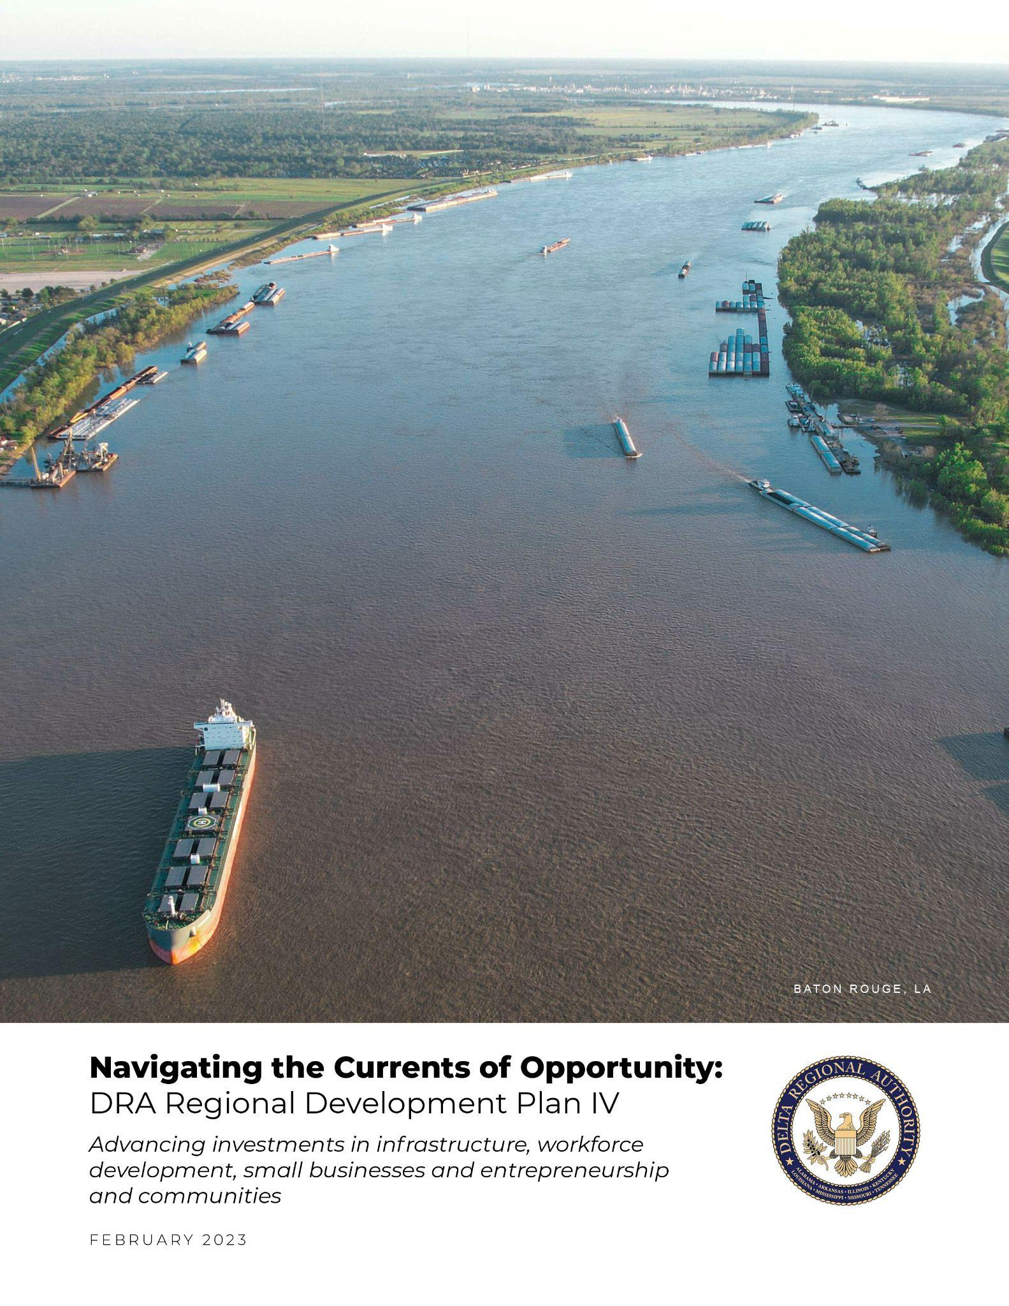
Regional Development Plan IV
DRA’s Regional Development Plan IV will guide the agency’s strategic priorities and actions from 2023 through 2027 to help the region build on previous successes and maximize future opportunities. While the plan identifies regional challenges, it also identifies regional assets, strategies, and action steps that will lead to greater opportunity and prosperity in economically distressed communities. The goals outlined in the Regional Development Plan IV are as follows:
Goal 1: Invest in Public Infrastructure
Goal 2: Nurture Local Workforce Ecosystems
Goal 3: Promote Business Growth and Entrepreneurship
Goal 4: Support Community Place-Making and Capacity-Building
DRA.GOV
10

Slide 13
Program Contact
Human Infrastructure
Sea Talantis
Director of Human Infrastructure
stalantis@dra.gov
(205) 603-3686
Critical Infrastructure
Amanda Allen
Director of Critical Infrastructure
aallen@dra.gov
(662) 483-8203

Slide 14
Stay Involved
Keep up with the DRA and its programs by signing up for our email alerts:
Sign Up

Slide 15
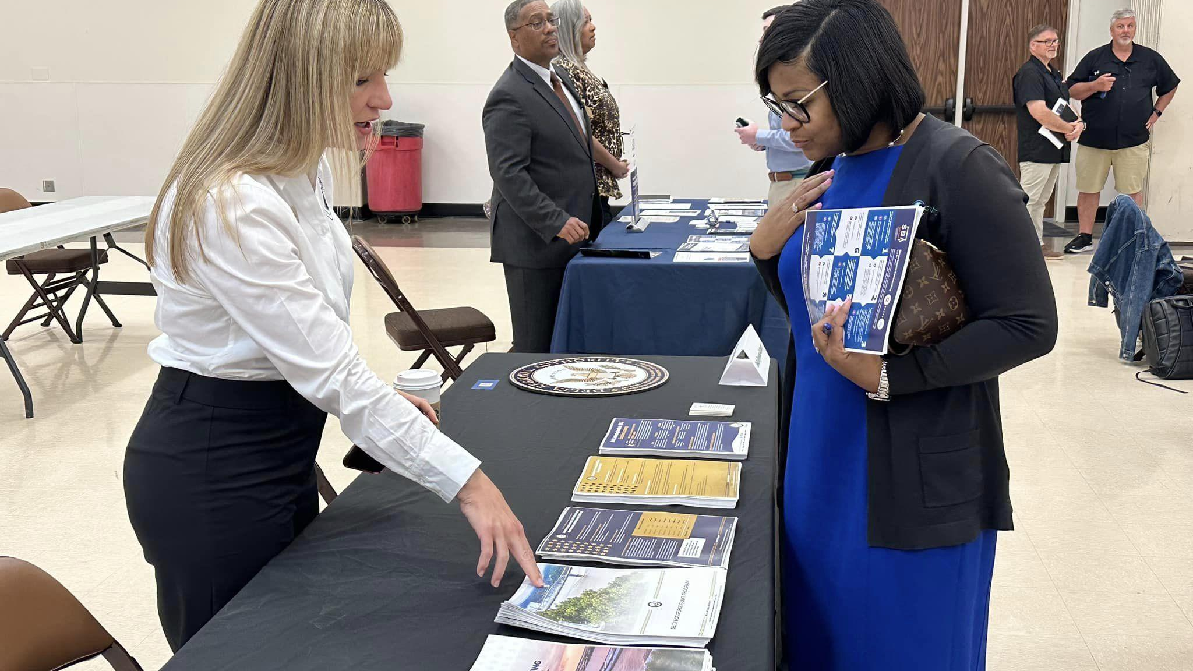

Slide 16
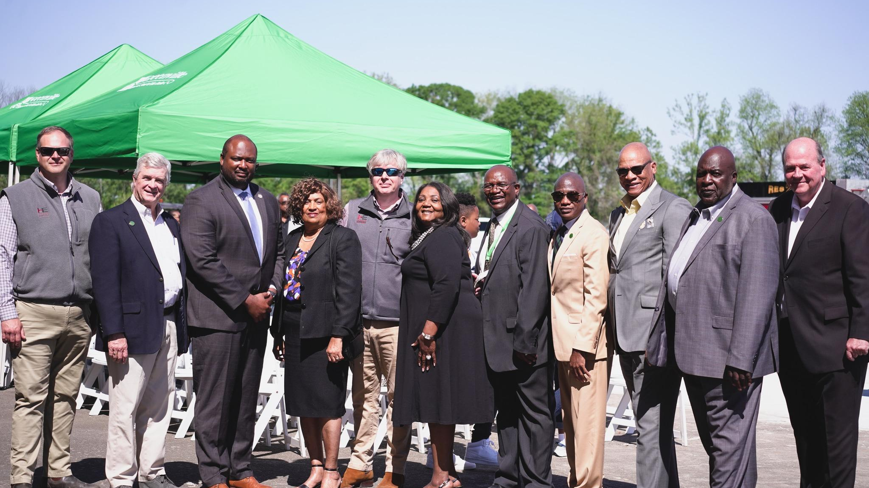
THANK YOU!

